Slide 1


SMART INDIA HACKATHON 2025
Problem Statement ID – 25067
Problem Statement Title- Proposal for Design and development of application on Heavy Metal Pollution indices
Theme- Miscellaneous
PS Category- Software
Team ID- 116347
Team Name- Decolians#3

Slide 2
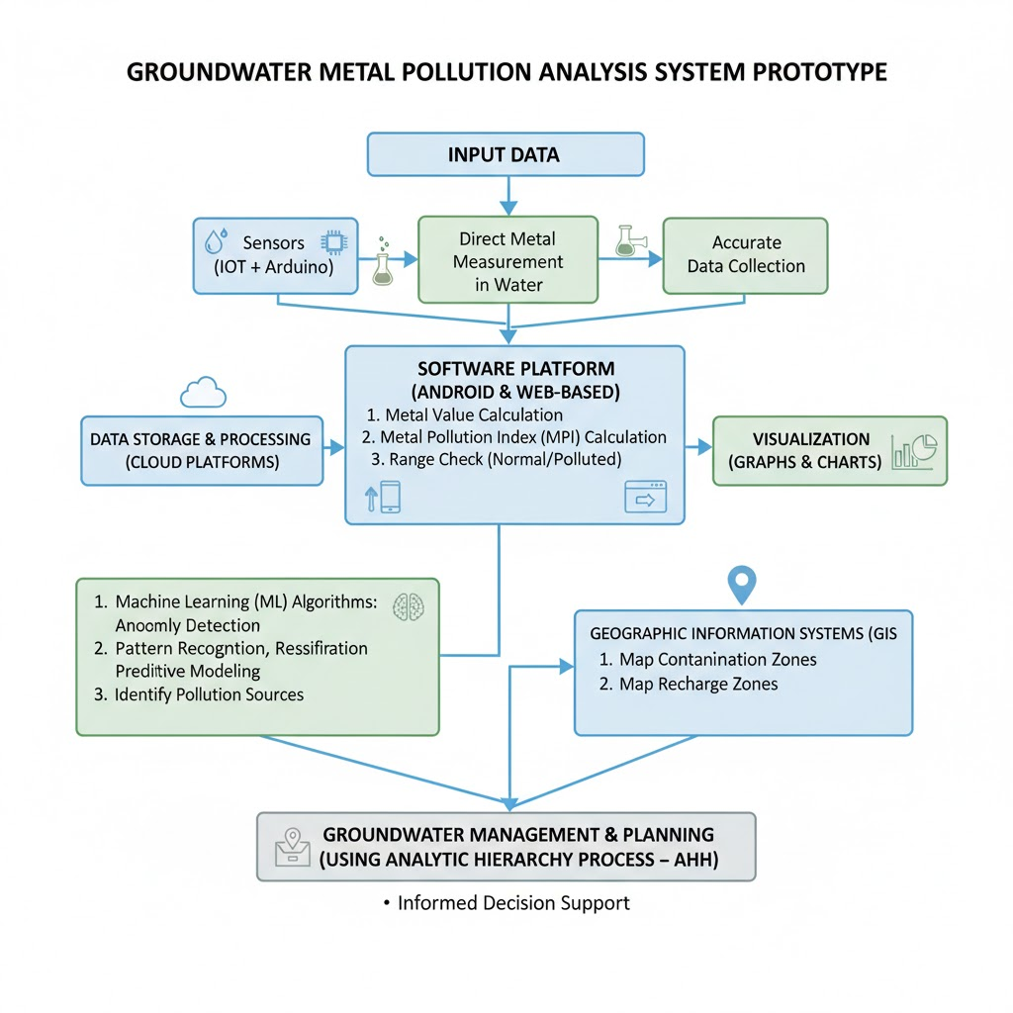
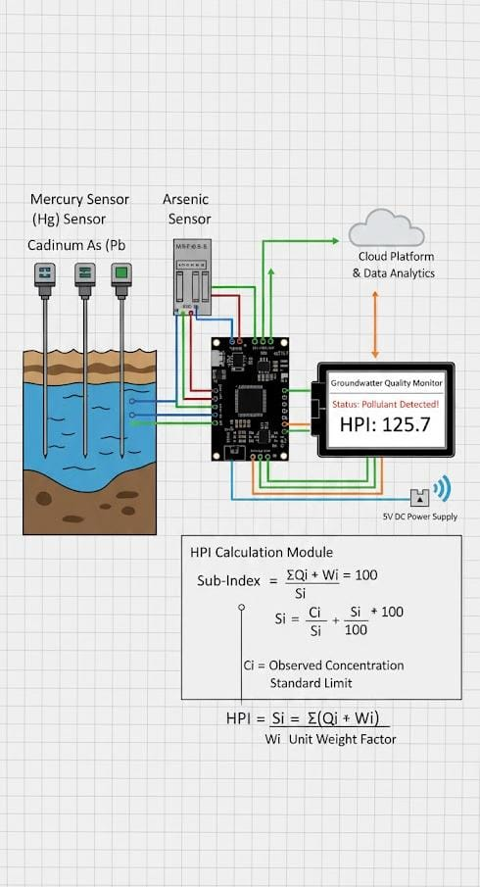
IDEA TITLE
Decolians#3
2

Slide 3
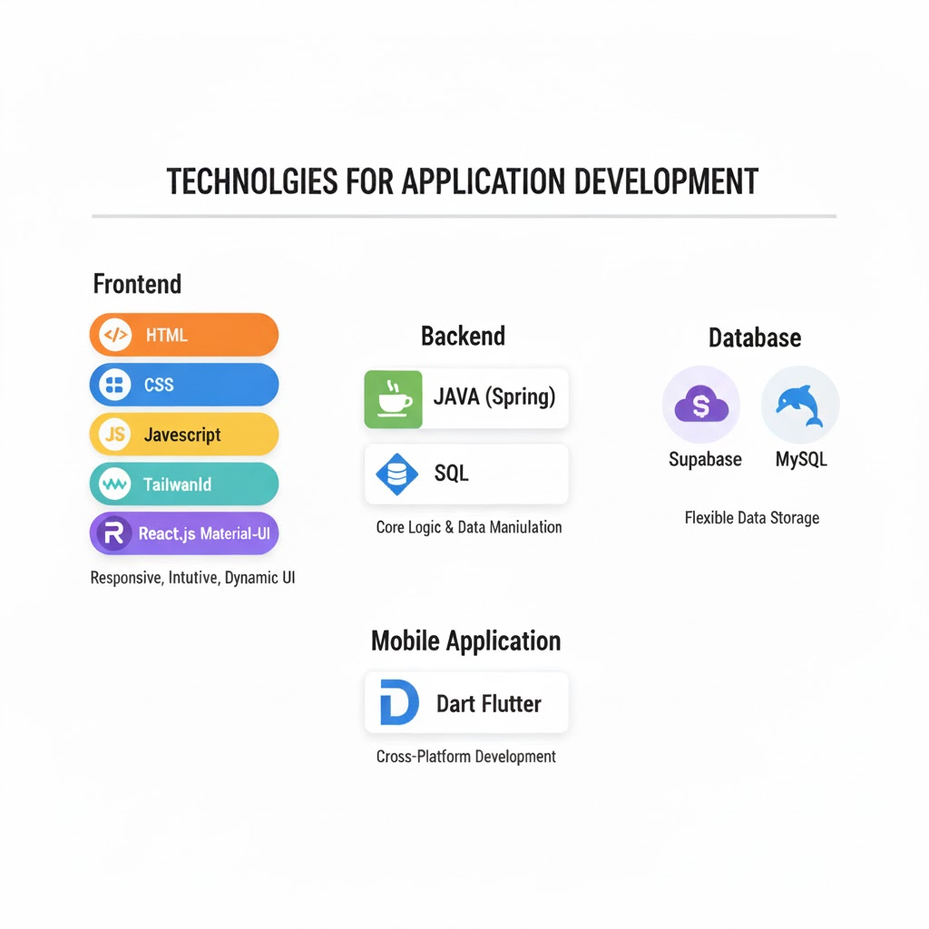
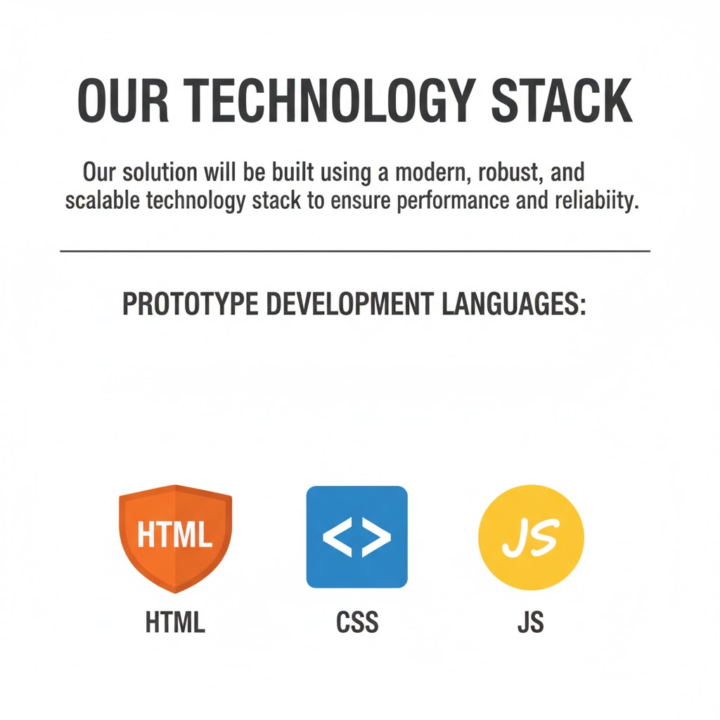
TECHNICAL APPROACH
Decolians#3

Slide 4
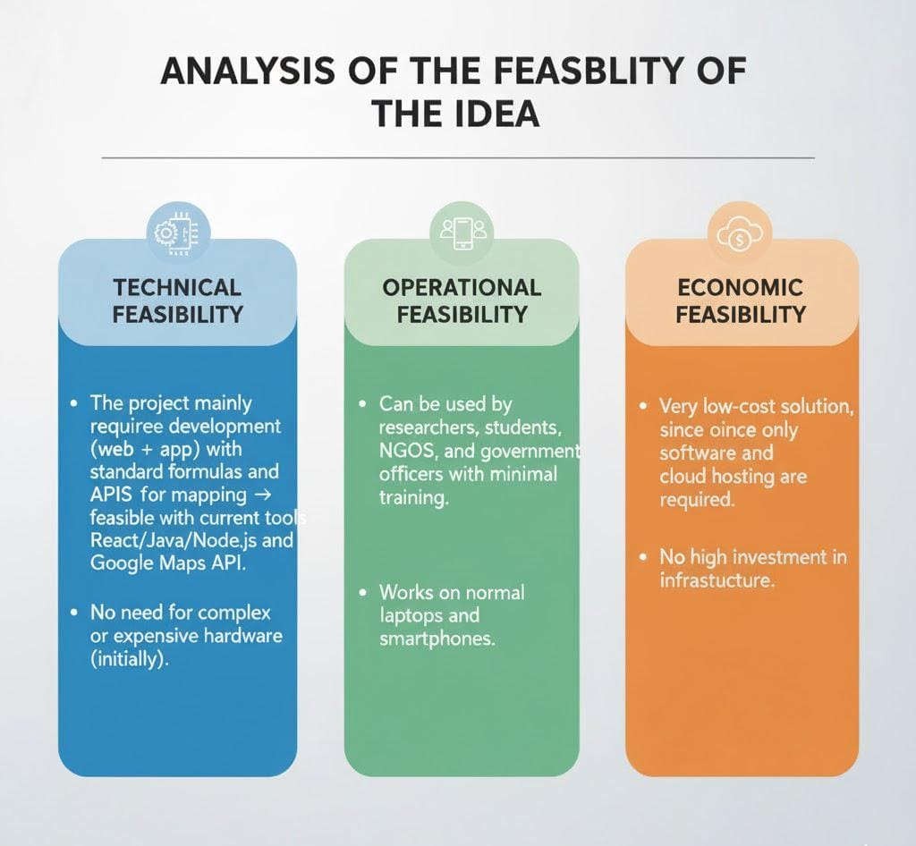
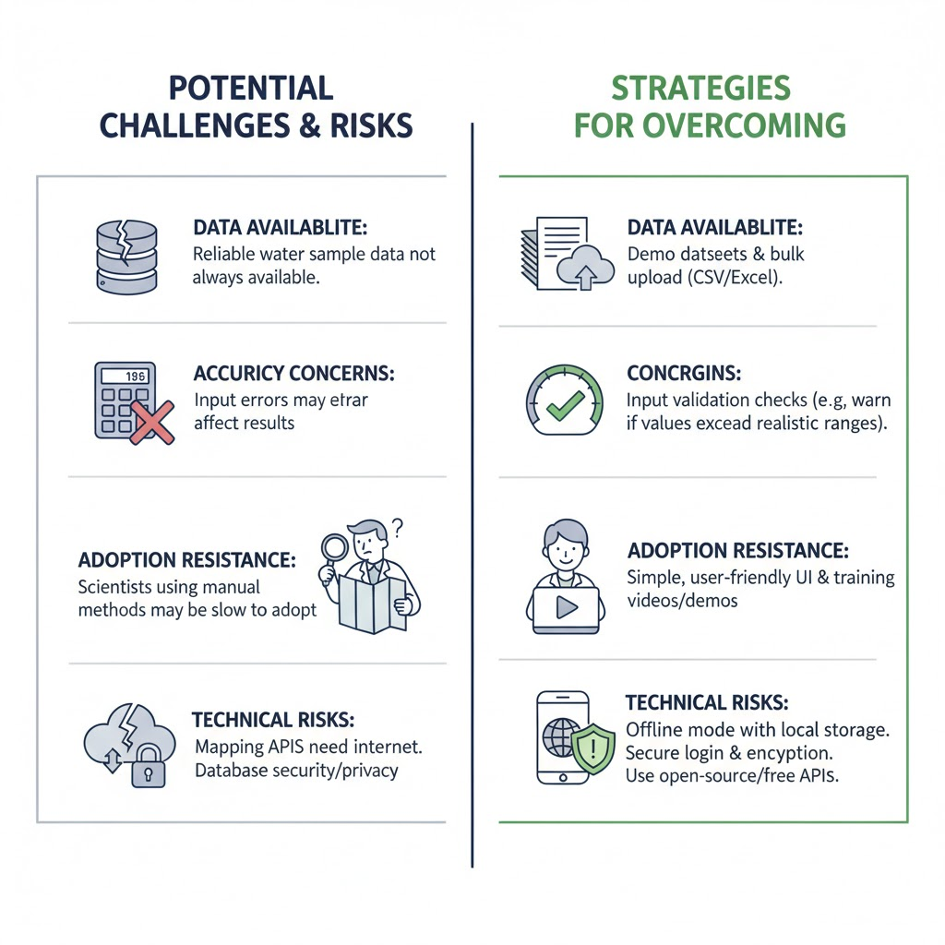
FEASIBILITY AND VIABILITY
Decolians#3

Slide 5
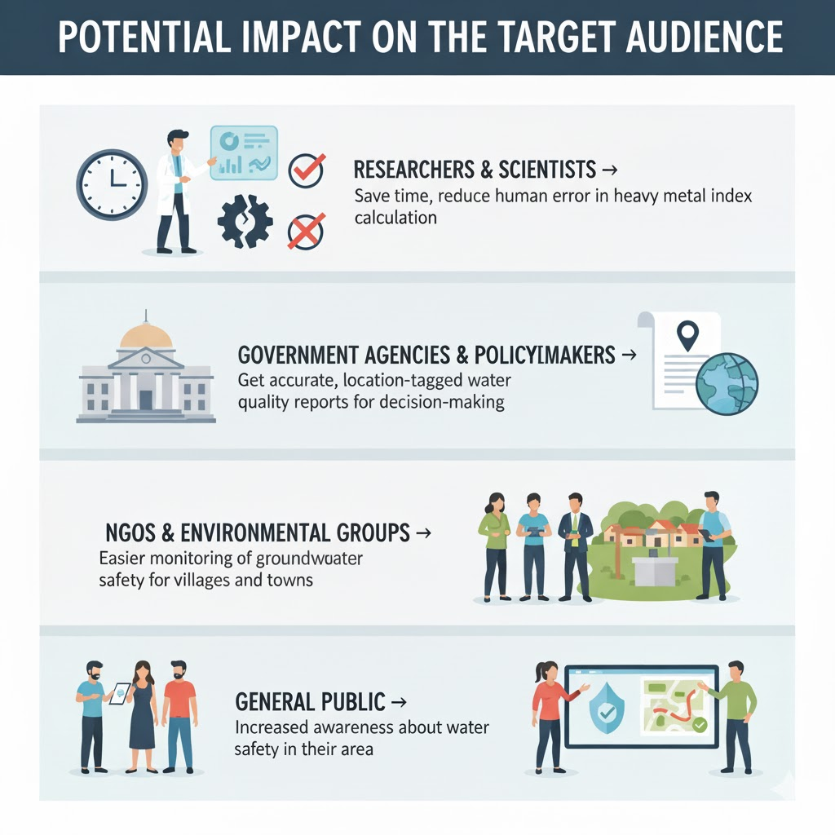
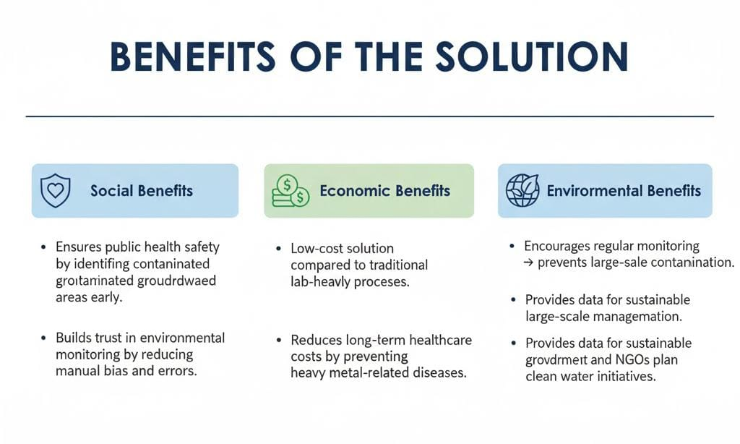
IMPACT AND BENEFITS
Decolians#3

Slide 6
RESEARCH AND REFERENCES
Decolians#3
🔹 Research Findings:
Studied global and national standards for permissible heavy metal limits (WHO, CPCB, BIS).
Reviewed recent studies on sensor integration, cloud analytics, and pollution indices.
Identified gap: Need for a digital system that computes and visualizes HMPI automatically.
🔹 References:
Central Pollution Control Board (CPCB) – Annual Report on Water Quality, 2023.
WHO – Guidelines for Drinking Water Quality, 2022.
Bureau of Indian Standards (BIS) – IS 10500:2012, Drinking Water Specification.
IEEE Xplore – IoT-based Real-Time Water Quality Monitoring System, 2021.
ResearchGate – Computation of Heavy Metal Pollution Index (HMPI), 2020.
data.gov.in – National Open Data Portal, India.
cpcb.nic.in – Official CPCB Portal.

